Slide 1
Hemoglobin Structure & Function
Notes:
Haemoglobin structure & function
Objectives:
Structure of Hb
Types of Hb
Functions & functional adaptations of Hb
Abnormal Hb/Haemoglobinopathy
Investigations for Hb.

Slide 2
Objectives
Explain the components of the Hb
Outline the types of Hb
List the functions of Hb
Draw & explain the oxygen Hb dissociation curve
Understand the molecular basis of Hemoglobinopathies

Slide 3
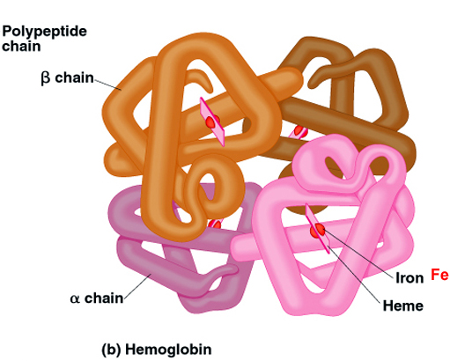
Haemoglobin Structure
Globular protein made from “haem” groups and “globin” chains
Heme group
    Porphyrin ring
    Ferrous iron
Globin chain
    2 Alpha chains
    2 Beta chains

Slide 4
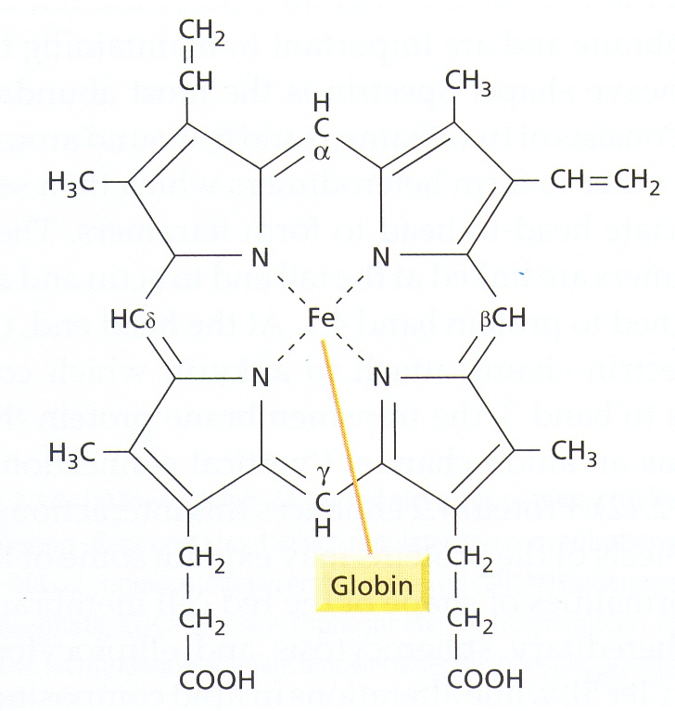
Arrangement of Haem Group
Fe²⁺ can form 6 bonds;
with the porphyrin nitrogen of the planar ring
with the side chain of histidine of globin proteins
1 with O₂
Fe²⁺ centered pyrrole ring arrangement

Slide 5
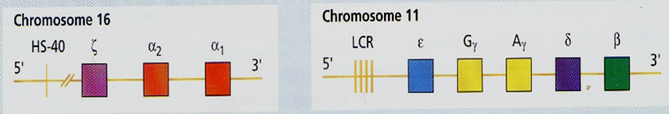
Globin Structure
Globin proteins are encoded by globin genes
Eight functional globin genes arranged in two clusters the
    b- cluster (b, g, d and e globin genes) on the short arm of chromosome 11
    a- cluster (a and z globin genes) on the short arm of chromosome 16

Slide 6
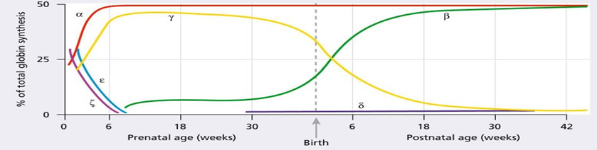
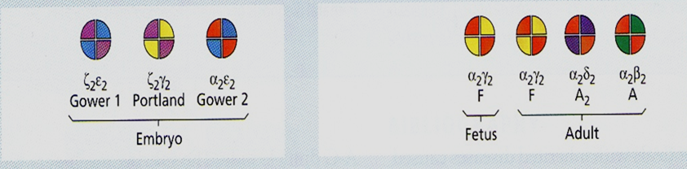
Globin Gene Clusters
Each globin gene express in different developmental stages

Slide 7
Normal Human hmoglobins
Various types of globin combines with haem to from different hemoglobin
Embryonic | Hb Gower 1 Hb Gower 2 Hb-Portland | ζ2ε2 α2ε2 ζ2γ2
Fetal | Hb F Hb Barts | α2γ2 γ4
Adult | Hb A Hb A2 Hb F | α2β2 α2δ2 α2γ2

Slide 8
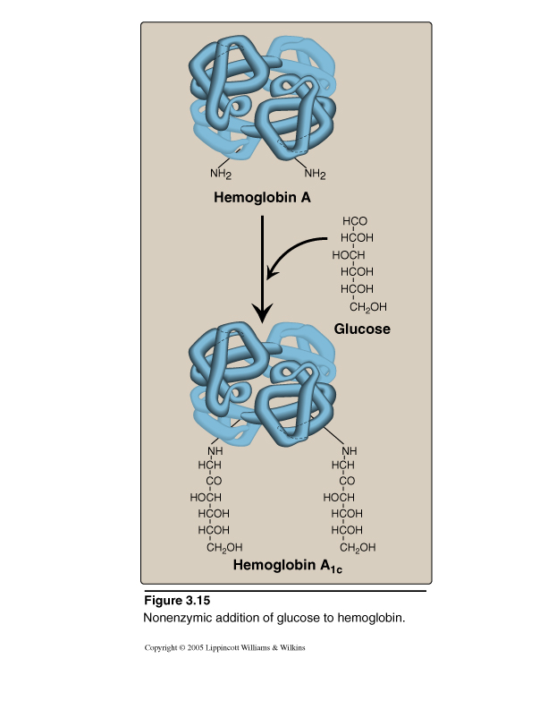
Glycosylated Hemoglobin (Hb A1C)
Most abundant form is HBA1c in which glucose residues attached to β-globin chains in hemoglobin RBCs.
Increased amounts of HBA1c are found in RBCs of patients with diabetes mellitus (DM) - an indicator of DM

Slide 9
Adult hemoglobin (HbA)
Adult hemoglobin is a tetramer of two identical dimers, (αβ)1 and (αβ)2
2 polypeptide chains within each dimer tightly held together by hydrophobic interactions
2 dimers are held together primarily by polar bonds (ionic and hydrogen bond).
Weaker interactions between dimers result in the two dimers occupying different relative positions in deoxyhemoglobin as compared with oxyhemoglobin

Slide 10
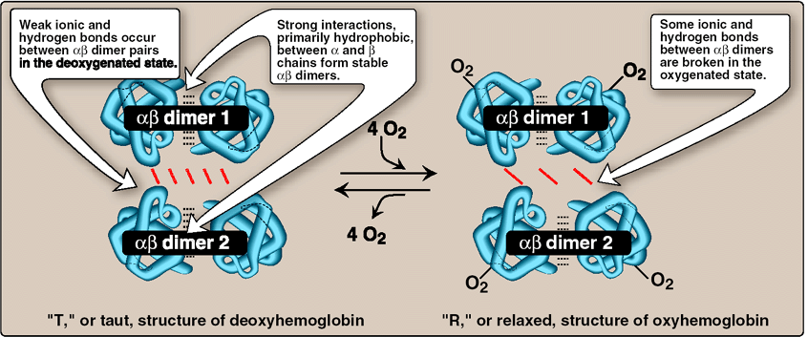
Oxygenation & deoxygenation of hemoglobin
(Oxyhemoglobin & Deoxyhemoglobin)
Deoxyhaemoglobin
“T” Taut structure
Oxyhaemoglobin
“R” Relaxed structure

Slide 11
Functions of Hemoglobin
O₂ Transport
CO₂ Transport
Act as a buffering system

Slide 12
Oxygen transport
The amount of O₂ bound to hemoglobin and released to tissues depends on;
  PO₂
  PCO₂
  Affinity of hemoglobin for O₂

Slide 13
Oxygen Affinity
Oxygen affinity is the ease with which hemoglobin binds and releases oxygen.
oxygen affinity cause O₂ to binds with Hb more and does not want to be released
oxygen affinity, cause O₂ to be released.

Slide 14
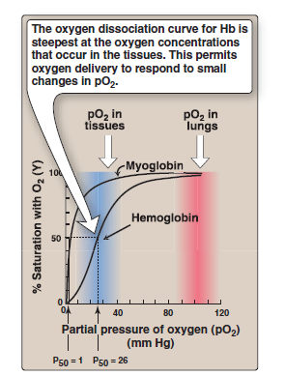
Oxygen-hemoglobin dissociation curve
O₂ carrying capacity of Hb at different PO₂
Sigmoid shape
Binding of one molecule facilitate the second molecule binding (corporative binding of O₂ )
P 50 (partial pressure of O2 at which Hb is half saturated with O₂) 26.6mmHg

Slide 15
Hb-oxygen dissociation curve
Position of curve depends on;
    Concentration of 2,3-DPG
    H⁺ ion concentration (pH)
    CO₂ in red blood cells
    Structure of Hb

Slide 16
Hb-oxygen dissociation curve
Right shift (easy oxygen delivery and favours unloading)
    High 2,3-DPG
    High H⁺
    High CO₂
    HbS
Left shift (give up oxygen less readily and favours loading)
    Low 2,3-DPG
    HbF

Slide 17
↓ Temp, CO₂ , 2-3 BPG; ↑ pH, Hb S
100
80
P₅₀
↑ Temp, CO₂ , 2-3 BPG;↓ pH
HbF
60
%Saturation
40
P₅₀
20
0
20
40
60
80
100
PO₂ (mmHg)

Slide 18
Hb as CO₂ Carrier
CO₂ carries in blood in three ways
as HCO₃ (80%)
Simple solution (10%)
Carbamino compounds (10%)
CO₂ bind to the Hb at different site
CO₂ + Hb-NH₃⁺ 2H⁺ + Hb-N-COO⁻
N terminal amino acid of Hb Carbamino Hb
Rate of reaction is very high.
Binding of CO₂ stabilizes the T form.

Slide 19
Buffering action of Hb
Hb has 6 times buffering capacity of plasma proteins.
The imidazole groups of Histidine are responsible for this.
Hb buffer systems are
Oxy- HB -
H-HbO₂/HbO₂;
pKa = 6.62 (arterial)
Deoxy- HB -
H-Hb/Hb
pKa = 8.18 (venous)

Slide 20
Carboxyhemoglobin
    CO bound Hb
    Favour R state
    Left shift
    Change Hb curve from sigmoid to hyperbolic
Methemoglobin
    Iron is in the oxidized state Fe³⁺ (ferric) state
    cannot bind oxygen

Slide 21
Carbon monoxide poisoning
CO + Hemoglobin Carboxyhemoglobin
Result in tissue hypoxia and death due to;
1. CO has greater affinity for Hb than that of O₂
CO compete effectively with O₂ for Hb.
2. Binding of CO increases the affinity for O₂
Decline O₂ unloading at tissue level.

Slide 22
Hemoglobinopathy
Haemoglobin II
Genetic abnormalities in the “globin genes” give rise to
- reduced production or absence (thalassemia)
- abnormal hemoglobin (structural variants)
Collectively called (hemoglobinpathies)

Slide 23
Thalassemia
Mutations can reduce or eliminate the production of one type (α or β) of globin polypeptide
Leads to insufficient or absence of one type of polypeptide in Hb
Most common single gene disorder
Two main types
α thalassemia and β thalassemia.

Slide 24
β Thalassemia
Locus of the β globin gene Chromosome 11
Commonly due to point mutation in β globin gene
  Transcriptional mutants
  RNA splicing mutants
  Translational mutants
  RNA cleavage and poly A mutants
Less commonly due to deletions
α globin synthesis is normal

Slide 25
β Thalassemia
β
β
β
β
β
β
Normal
β-Thalassaemia minor
β-Thalassaemia major
Globin gene mutations in β- Thalassaemias

Slide 26
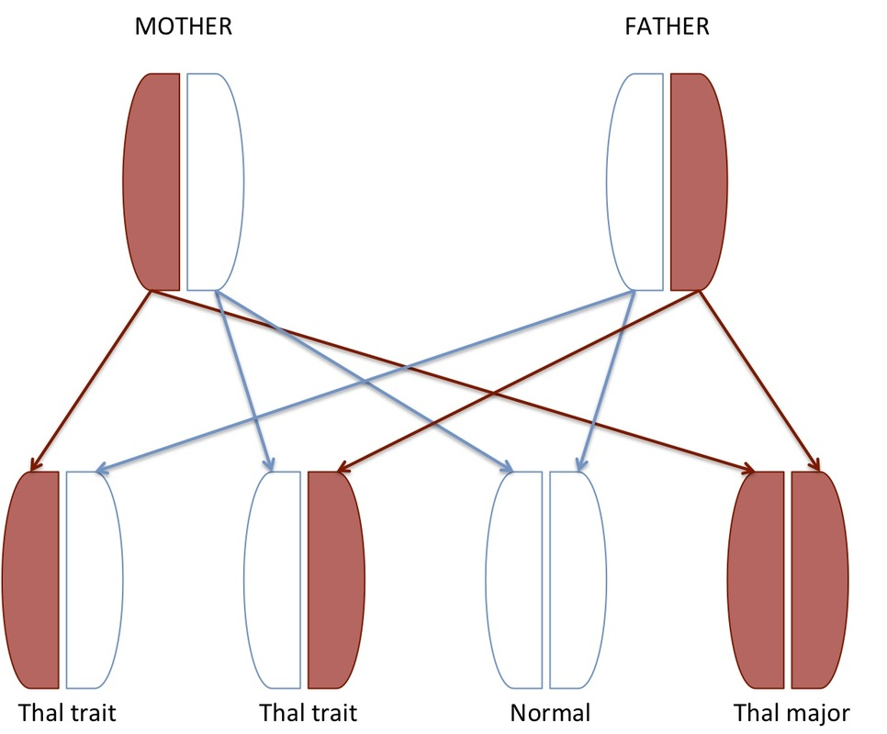
Inheritance of thalassemia

Slide 27
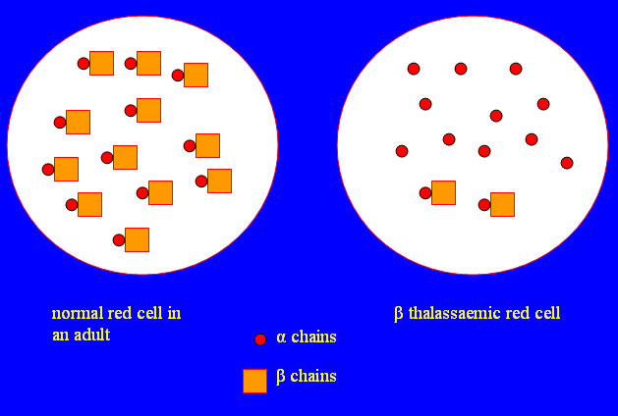

Slide 28
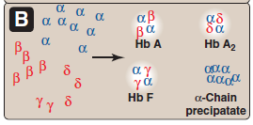
Hemoglobin tetramers formed in β-Thalassemia

Slide 29
α Thalassemia
α globin locus - chromosome 16
Due to the defect in the synthesis of α globin
Typically as a result of deletional mutation
Lesser extent due to point mutations

Slide 30
α- Globin gene deletions in α -thalassemia
Chromosome 16
α1
α2
α1
α2
α1
α2
α1
α2
Normal
‘Silent” carrier
α1
α2
α1
α2
α1
α2
α1
α2
Α-Thalassaemia trait
α1
α2
α1
α2
α1
α2
α1
α2
Heamoglobin H disease
Hydrops fetalis

Slide 31
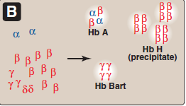
Hemoglobin tetramers formed in α-thalassemia

Slide 32
Structurally abnormal Hb or Hb variants
HbS
Results in sickle cell anemia
Genetic disorder of the blood caused by a single
nucleotide alteration GTG …….GAG (a point mutation) in the β-globin
Incorporation of valine instead of glutamate in HbS make the out side of the molecule non polar
Generate a sticky patch on the out side of the molecule.
HbA ( β globin )
HbS (β globin)
6th position ….Glutamate……
6th position …..Valine.............

Slide 33
Deoxygenated HbS bind to sticky patches of the adjacent deoxygenated HbS forming filaments.
RBC that have those filaments deformed in to crescents, sickle like shape.
Sickle cell anemia is inherited as a homozygous recessive disorder
Sickle disease - α₂^{A} β ₂^{S}
Sickle cell trait - α₂^{A} β ₂^{A} β ₂^{S}

Slide 34
HbC
Molecular defect is single nucleotide substitution at 6th position of the beta globin chain
Mild symptoms than sickle cell disease
HbA ( β globin )
HbC (β globin)
6( Glu)
6(Lys)

Slide 35
Hb E
Due to point mutation at CD 26 GAG-AAG
Amino acid change Glu-Lys
Common in Asia including Sri Lanka
Has a phenotype of a mild to severe form of β thalassemia
Hemoglobin E β thalassemia is by far the most common severe form of β thalassemia in Asia

Slide 36
HbM
Formation of HbM due to
  unacceptable missense mutation in the α or β globin chain
Mutation alter the active site of Hb & as a result favors the formation of metHb
MetHb can nor longer bind oxygen.

